Slide 1
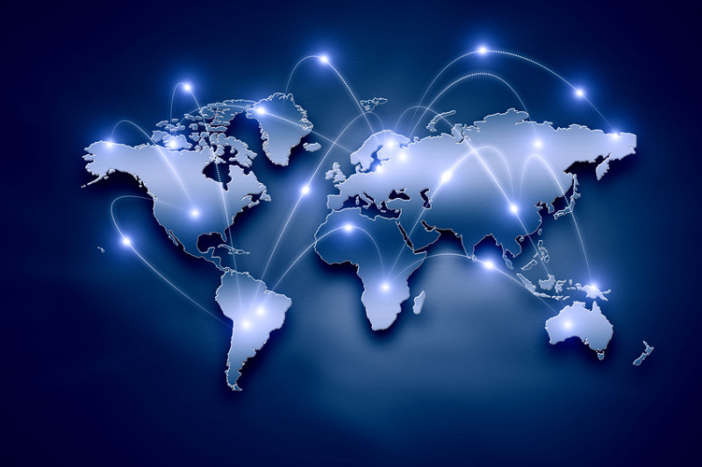
“The Next Big Revolution: Internet of Things and Its Applications”
Dr Annapurna P Patil Manoj more S Suresh V
Associate Professor, BE Student, BE Student,
M S Ramaiah Institute Of Technology M S Ramaiah Institute Of Technology M S Ramaiah Institute Of Technology
Bengaluru , Karnataka , India Bengaluru , Karnataka , India Bengaluru , Karnataka , India
annapurnap2@yahoo.com Manoj8894s@gmail.com er.sureshvelu@gmail.com

Slide 2

Overview
Introduction
What IoT connects ?
Device ability
Wireless Data Acquisition system.
ComConCos’s of IoT.
What Is IoT Based On and Its Working.
Application of IoT.
Advantages of IoT.
Challenges In IoT.

Slide 3

Introduction
We may define “Internet Of Thing has Internet Of Everything that is Existing”
The Internet of Things (IoT) is generally thought of as connecting things to the Internet. The Internet of Everything (IoE) is the seamless connection of people, process, data and things.

Slide 4
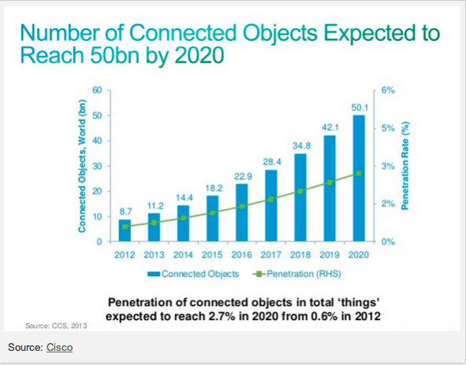
Cont…
Today about 5 billion devices “smart” connected to Internet.
Survey say there will be 50 billion connected devices by 2020

Slide 5
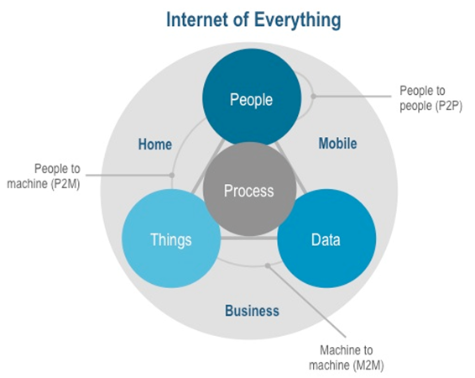
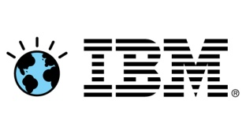
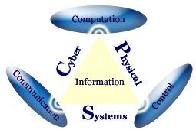
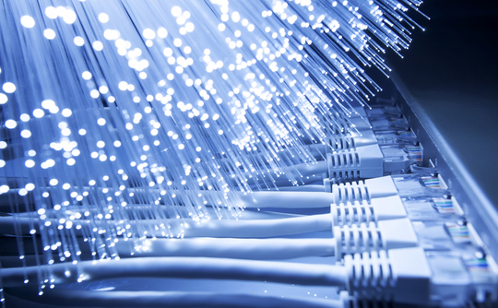
View of Companies
CISCO “Internet Of Everything”
IBM “Smart Planet”
TCS “CyberPhysical System”
We Term it has “Billion Connectivity” .

Slide 6
What IoT connects?
Connect Everything : Internet of Things networks began with connecting industrial Machines and equipment with each other were first they concentrated on Automating the industrial process.
Sensors for data collection : The physical device are being connected will possess one or more sensors Sensor has the ability to monitor a specific condition such as location, vibration, motion and temperature.

Slide 7
Devices Ability
Uniquely identified
communicate through wireless technologies
controlled from anywhere
Cloud provides the power to store, exchange, combine and process massive amounts of information.
But this devices also have a major challenges to be faced like
Energy consumption.
Address allocation…etc

Slide 8
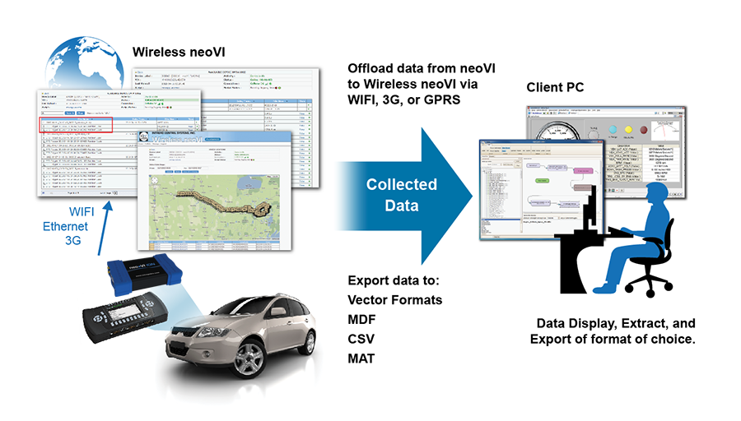
Wireless Data Acquisition system

Slide 9
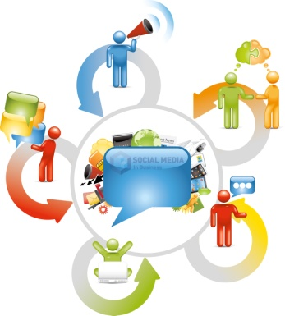


ComConCos’s of IoT
Communication
Control and Automation
Cost Convenient

Slide 10
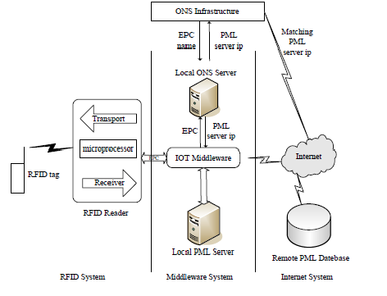
What Is IoT Based On and Its Working

Slide 11

Issues with respect to RFID
Leakage
Middleware Security
Internet Security

Slide 12
Application of IoT
Smarts City
Environmental Monitoring
Object tracking
Physical safety and perimeter
Infrastructure Management
Smart agriculture
Industrial Applications
Energy Management
Medical and Healthcare Systems
Building and Home Automation
Transport Systems

Slide 13
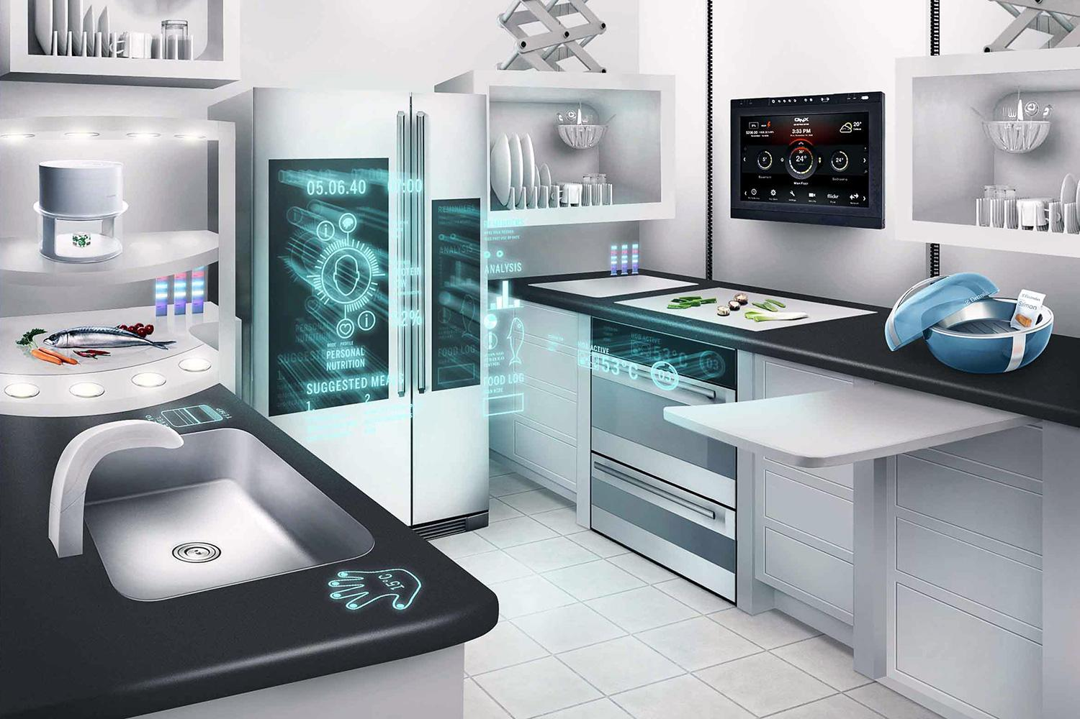

Slide 14
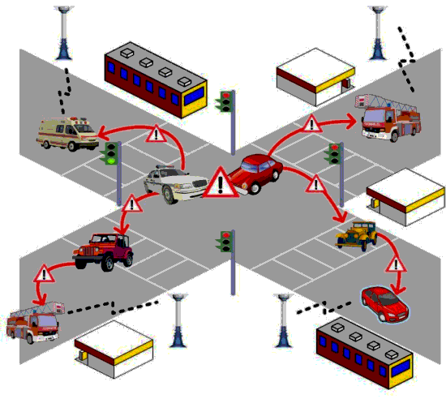

Slide 15
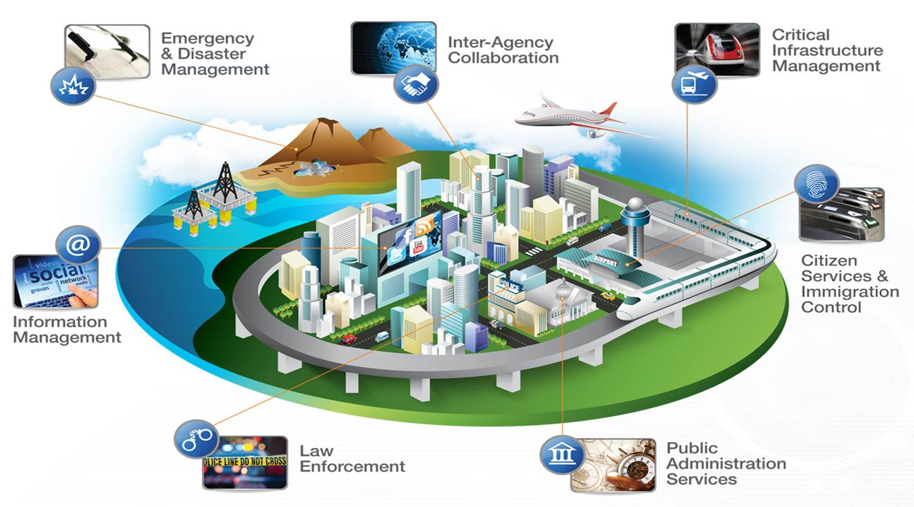

Slide 16
Advantages of IoT
Quick and smart Connectivity.
World of scan able information.
Inventory Management.
Wearable Computing.
Assessing web user intelligence.
Vending technology.

Slide 17

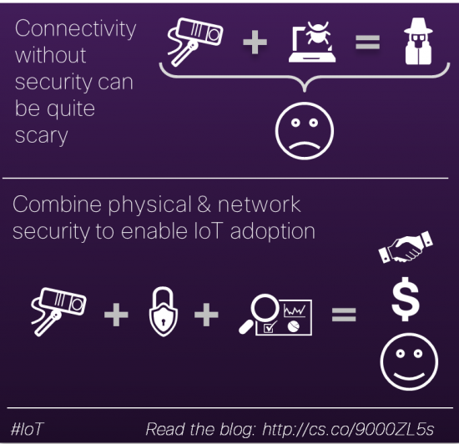
Challenges of IoT
Privacy and Security.
Organizational inability.
widespread malware.
Addressing problem.
Energy Consumption.

Slide 18
References
Jim Chase,” The Evolution of the Internet of Things”, Texas Instruments-September 2013.
“What Internet of Things Needs to Become a Reality”, freescale & ARM-May 2014
“An Introduction to the Internet of Things (IoT)” Copyright Lopez Research LLC-November 2013.
Jun Li, Y. Shvartzshnaider, J. Francisco, R. Martin, K. Nagaraja and D. Raychaudhuri, “Delivering Internet-of-Things (IoT) Services
Mobility First Future Internet Architecture”, Rutgers University October 24-26th, 2012.
Roberto I. Belda ,” Internet of Things: Advantages May Far Outweigh Its Drawbacks " January 26, 2014.

Slide 19
Cont…
Dave Evans,” The Internet of Things How the Next Evolution of the Internet Is Changing Everything”, Cisco April 2011.
Paul Smith,” What is the Internet of Things – and what does it mean to us all?”, Agar Scientific, January 2014
Chonggang Wang & Mahmoud Daneshmand, “Special Issue on Internet of Things (IoT): Architecture, Protocols and Services”, IEEE sensors journal, VOL. 13, no. 10, October 2013.
Xiao Nie & Xiong Zhong ,”Security In the Internet of Things Based on RFID: Issues and Current Countermeasures”, Published by Atlantis Press, Paris, France 2013.
Kevin Ashton, "That 'Internet of Things' Thing", RFID Journal, July 22, 2009.

